Slide 1

Why information security?
Выполнил: Цыпышев тимофей ИУ5-11б

Slide 2


Slide 3
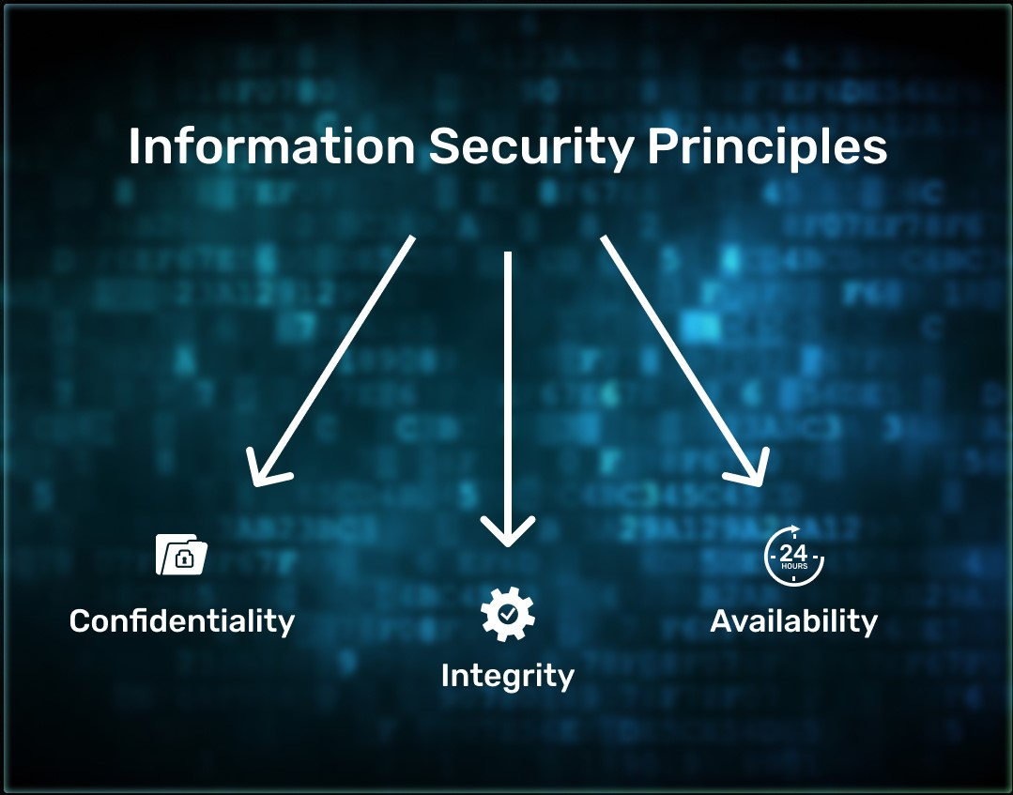
What Does Information Security Guard?
Confidentiality means that only those who have the right to do so have access to information.
Integrity means that information is preserved in full and is not changed without the owner's knowledge.
Availability means that whoever has the right to access information can obtain it.

Slide 4

Types of Information

Slide 5

Main Types of Confidential Information
Personal Information
Trade secret
Professional secret
Official secret
State secret

Slide 6


Briefly About Information Security

Slide 7

Questions???

Slide 8

thanks for watching

